Slide 1
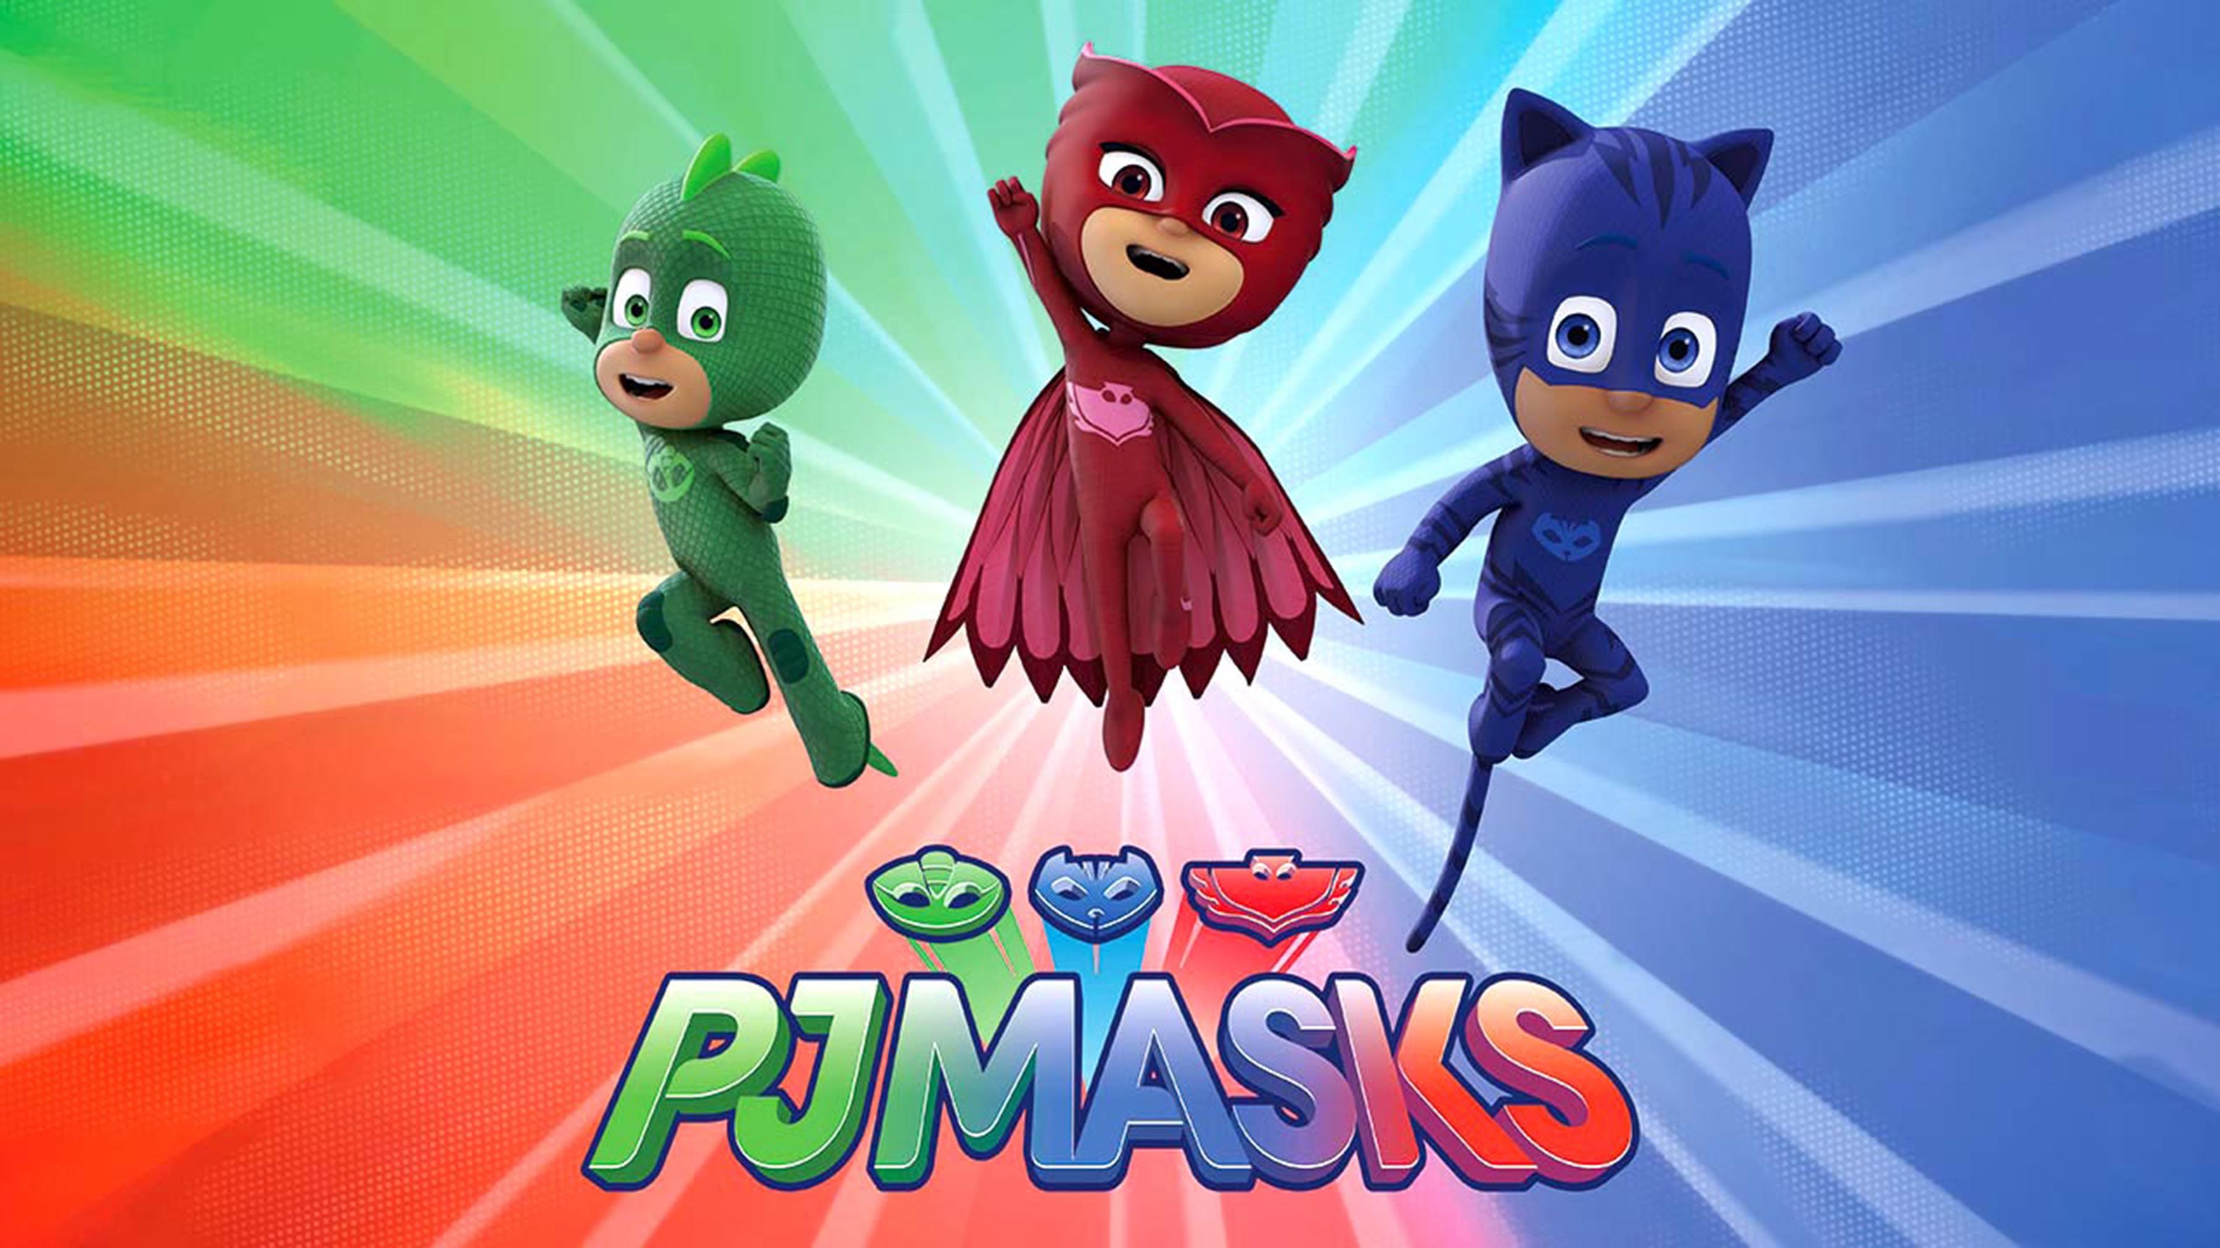
Story Promoter
By 4A (15) Kwok Chun Lok, Carson
Date: 16th Janurary, 2024

Slide 2
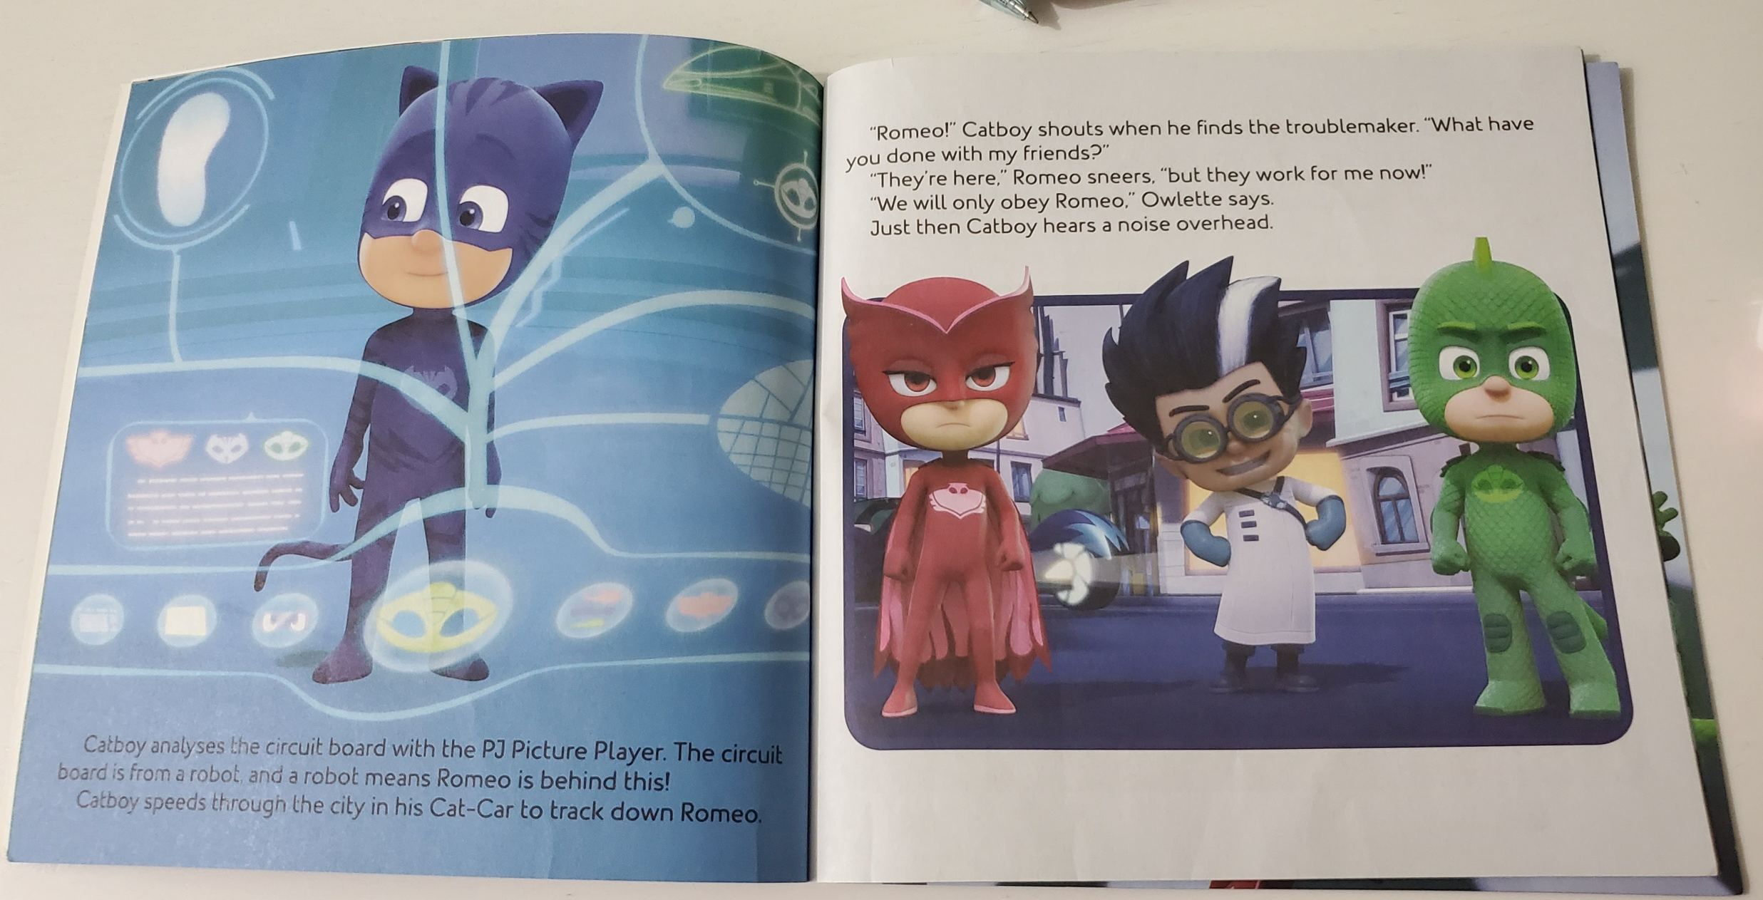
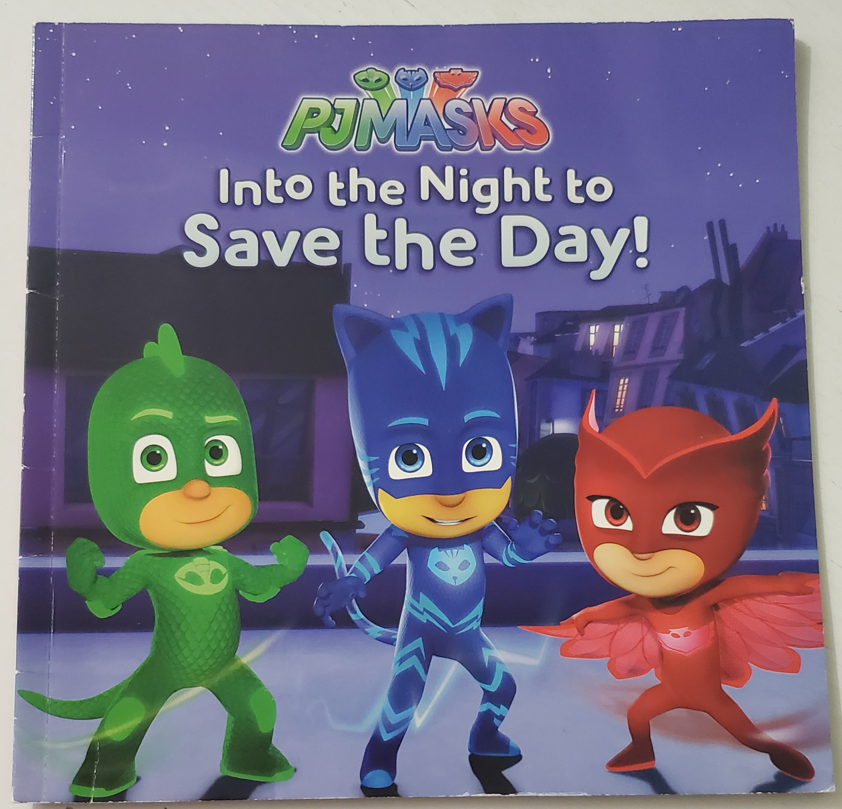
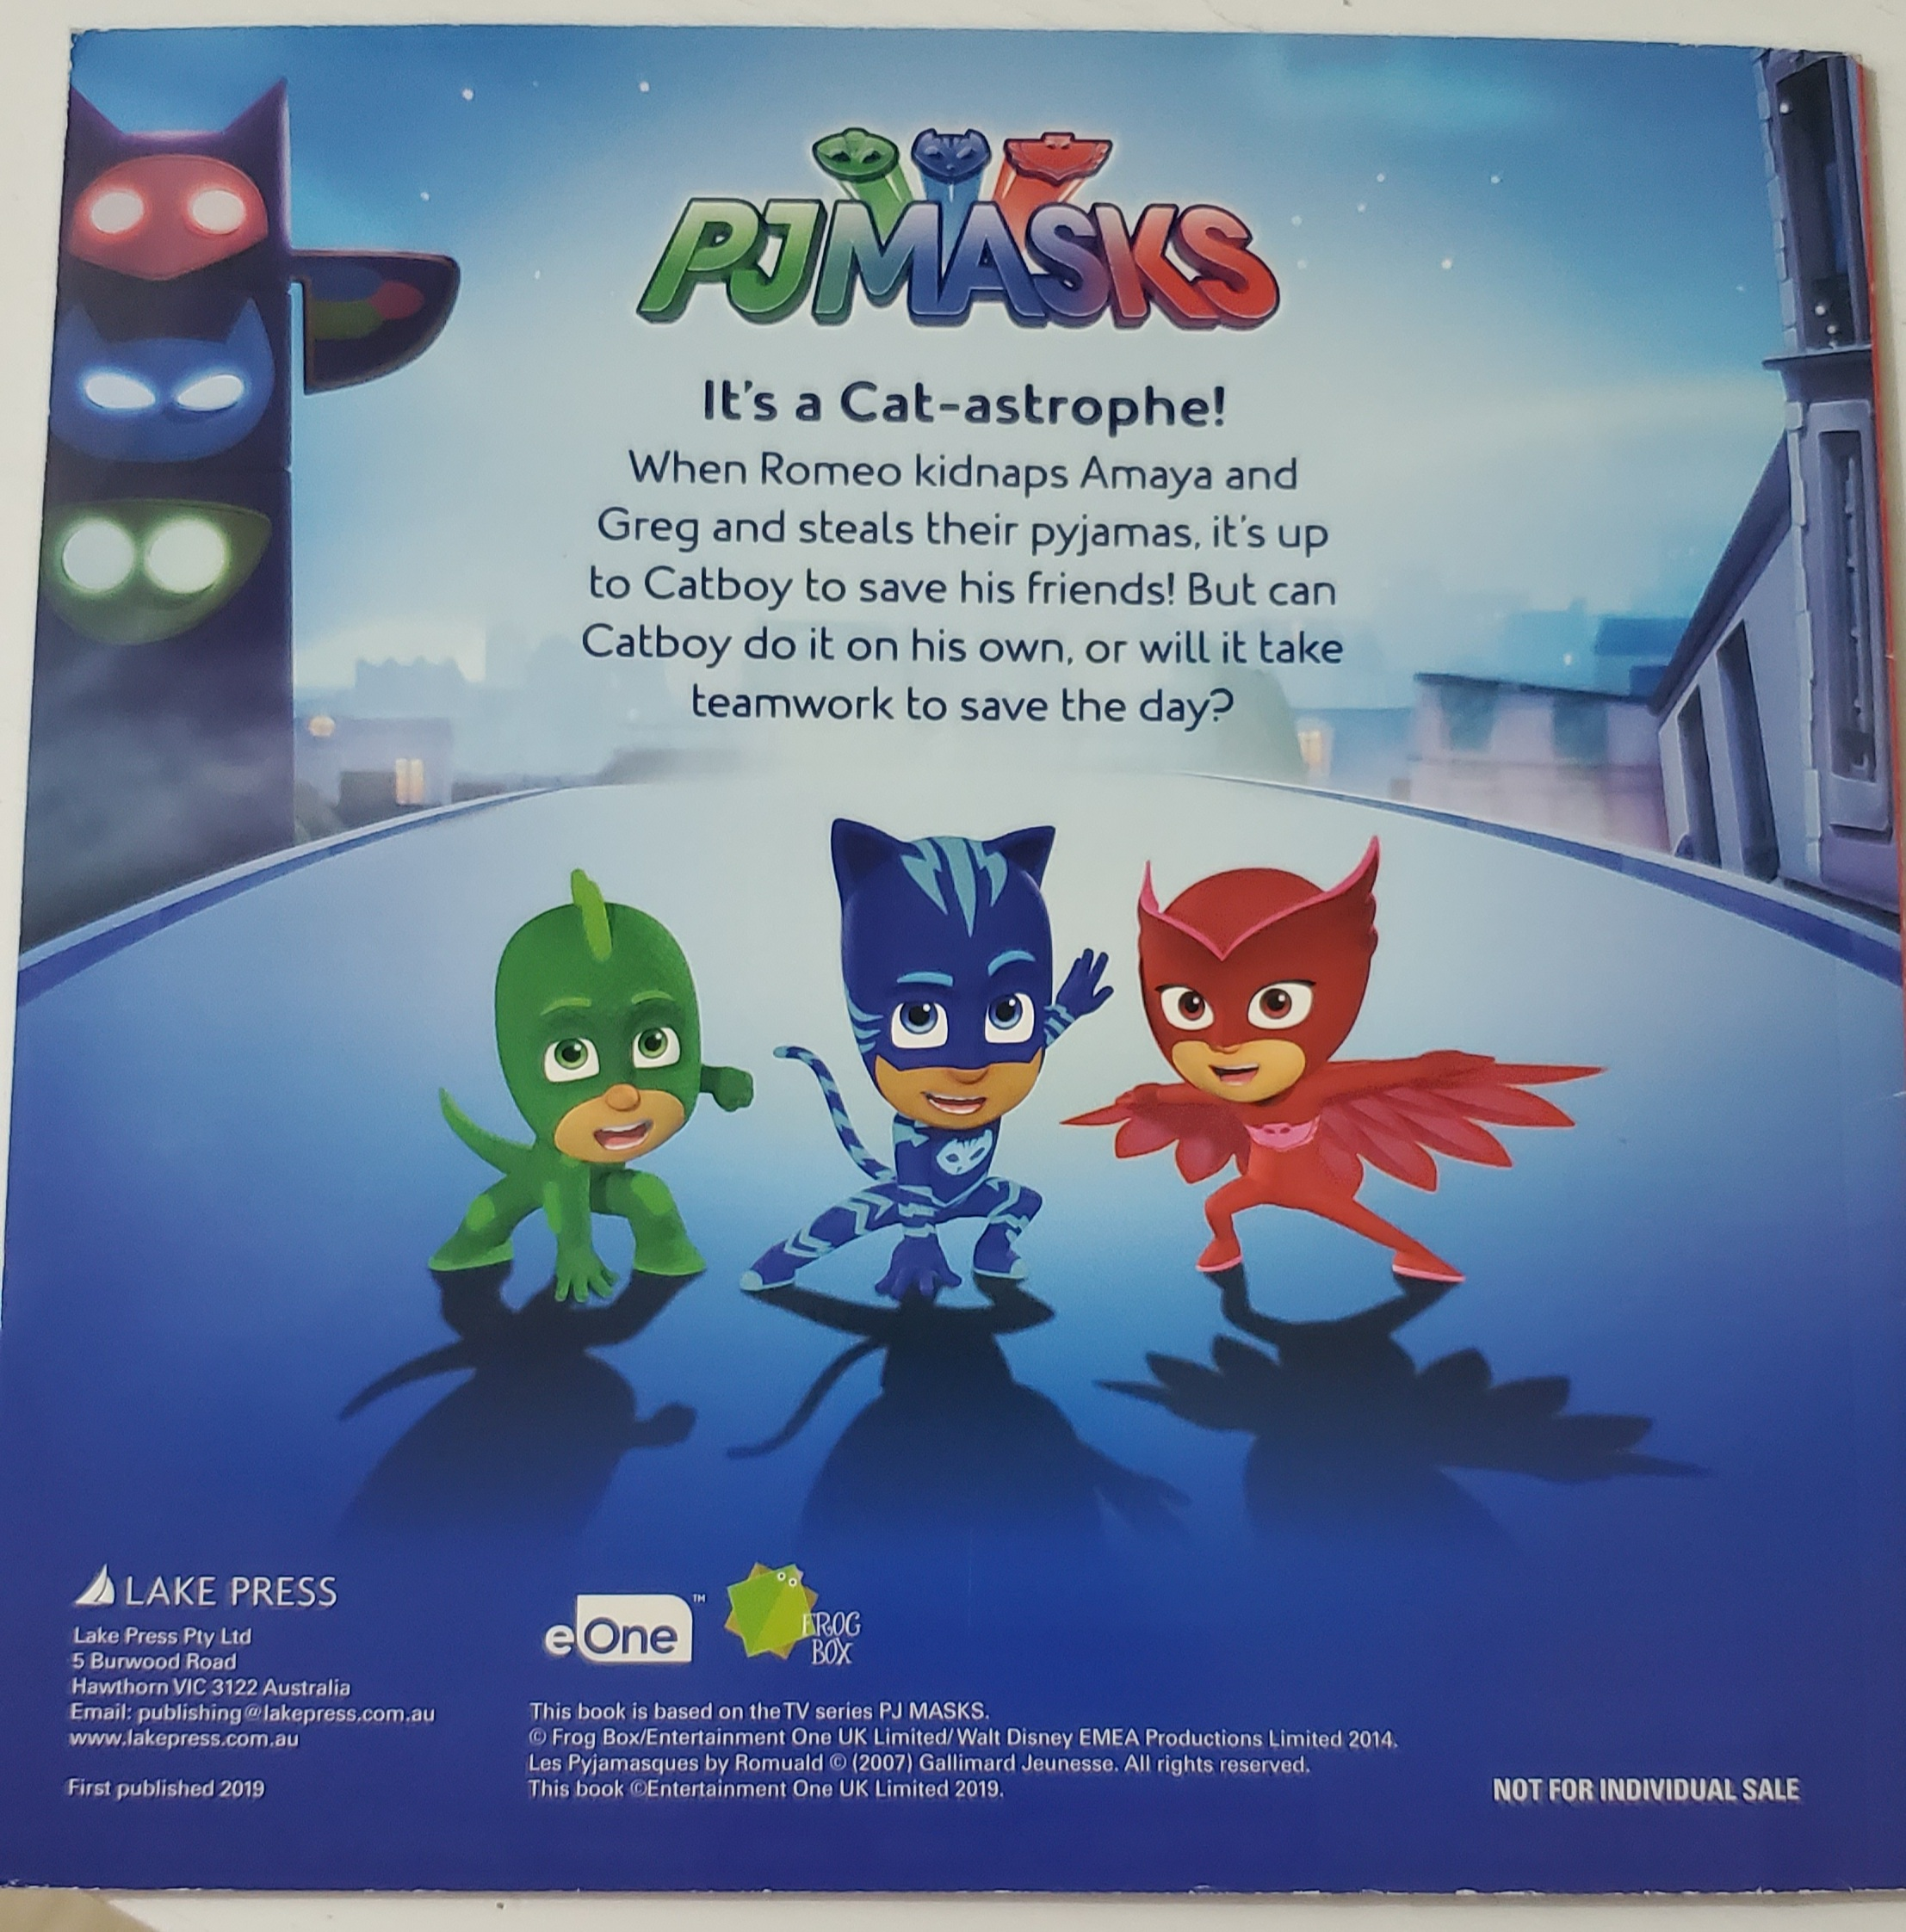
Title of the book
PJ Masks, Into the Night to Save the Day!

Slide 3
Outline
Title of my favourite book
My favourite character
His/her character strength
Key content of the story
My favourite part in the story
How do I rate the book
Who would I recommend the book to

Slide 4
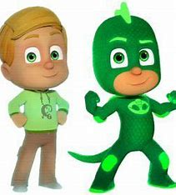
My Favourite Character
My favourite character is Greg who obtains powers by putting his green superhero pyjama as a lizard.
He becomes Gekko at night to fight various nighttime villains so as to save the world.
As one of the three PJ masks heros, their slogan is “PJ masks are on the way, into the night to save the day!”
He has many powers/ super abilities:
  To climb on walls and other surfaces
  To turn invisible whenever needed
  To lift extremely large and heavy objects
  To change colors of his costume
  To summon two shields attached to his arms to block incoming attacks
  To run on water like a basilisk lizard
Greg
Gekko

Slide 5
His Character Strength
Greg
Gekko
Strong
Brave
Confident
Helpful
Funny
Friendly
Willing to face challenges
Intelligent

Slide 6
Key Content of the story
While Greg, Connor and Amaya were playing outside, Greg and Amaya were suddenly trapped in cages by Romeo, the key nighttime villain who keens on taking over the world.
With the circuit board, Greg and Amaya became Romeo’s robots who were controlled to obey Romeo’s instructions.
After overcoming several attacks, they took back their pyjamas on to become Gekko and Owelette with the help of Catboy.
PJ masks worked as a superhero team to defeat Romeo and his other robots.

Slide 7
My favourite part of the story
No matter how hard it was, Catboy insisted to save his friends.
Greg and Amaya released themselves from cages based on their intelligence and trust on Catboy.
It showed the importance of friendship and teamwork based on mutual trust and support.

Slide 8
How would I rate the book?
Rating:
9 out of 10
Reasons:
Interesting, exciting and educational

Slide 9
Who would I recommend the story to?
My family
My classmates
My teachers
My cousins

Slide 10
The End – Thank You

