Slide 1

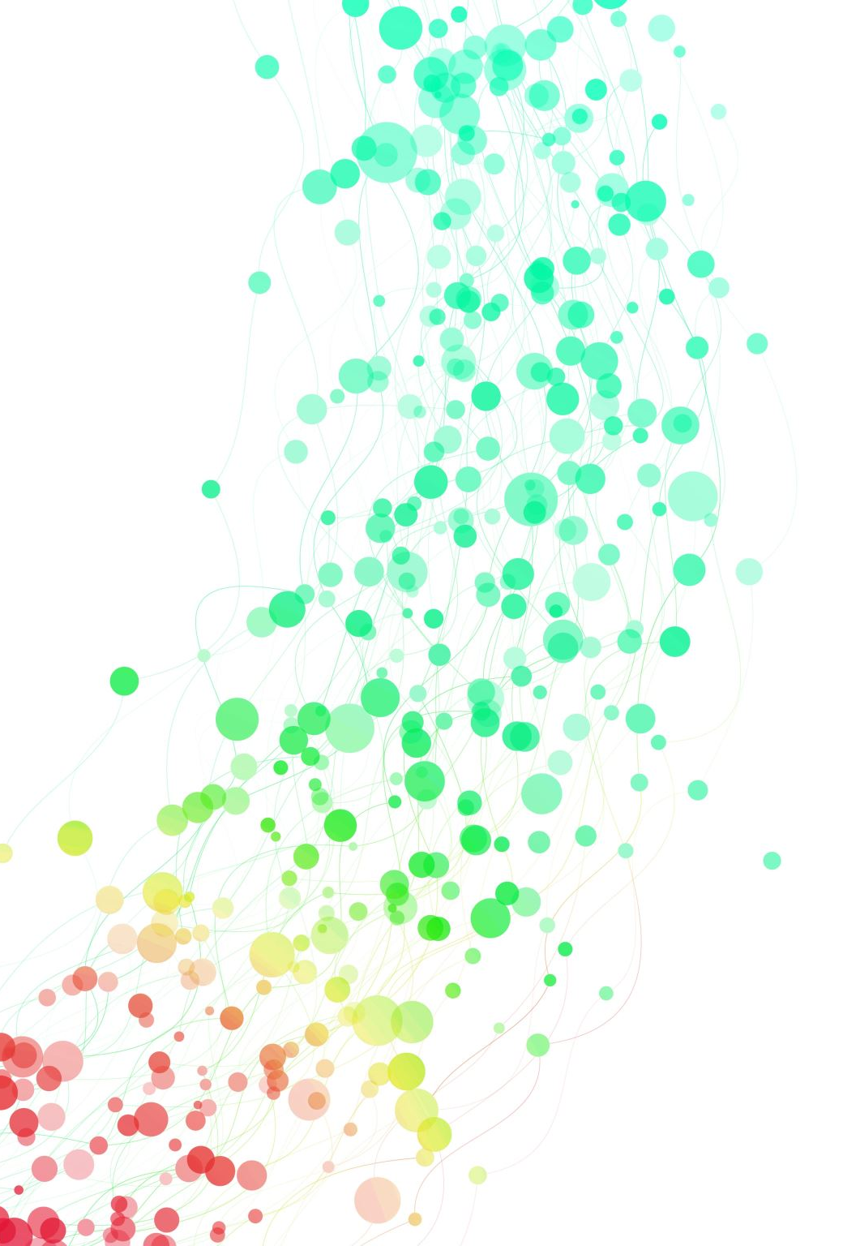
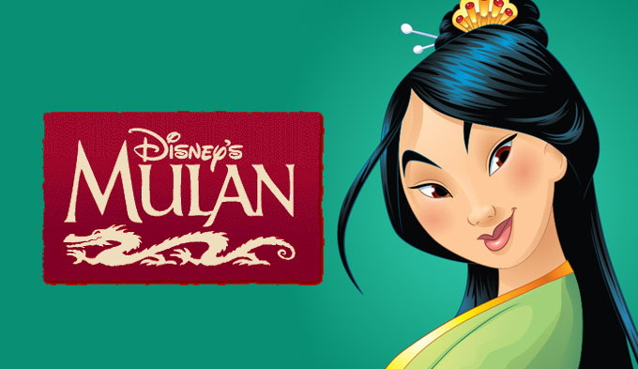
Mulan Story
- The name of my favourite character
- The character strength of Hua Mulan
- Things happen in the story
- My favourite part in the story
- Rating of the book
- Recommendation
權
權

Slide 2
The name of my favourite character is HUA MULAN.
The character of Hua Mulan
Brave
Kind
Loving

Slide 3
.
Thing happens in the story
Mulan decides to go to war on behalf of her father to fight.
My favourite part in the story
My favourite part in the story is when MULAN fights with Bori Khan.

Slide 4
Rating of the book
I rate this book (4 / 5) stars out of four because it is interesting.
Recommendation
I would recommend it to my brother because it is a touching story.

Slide 5
Thank You

